Slide 1

CAPI Menus
Supervisors and Interviewers
Notes:
Close tablets!

Slide 2
CAPI Menus
What?
Why?
When?
Who?
How?
Accessing tablets and all CAPI functions through a menu system
Simplify work, set up identifiers for the data
Before performing any survey activities, access the menu
Everybody! Supervisors and interviewers each have menus
Use passwords and find the link to the menu on the desktop
Notes:
“identifiers” for the data – meaning who did the interviewers, which teams they are on, which cluster they are in, which household it is, etc…
Note that if supervisors are acting as interviewers, they should access the interviewer menu

Slide 3



Steps in accessing the CAPI menus
From the home screen, click on the CSEntry icon and choose Interviewer/Supervisor
Check cluster number, Interviewer number
Begin work! Exit properly!
Notes:
Important to check the cluster number! No work can be done if the wrong cluster number has been selected

Slide 4
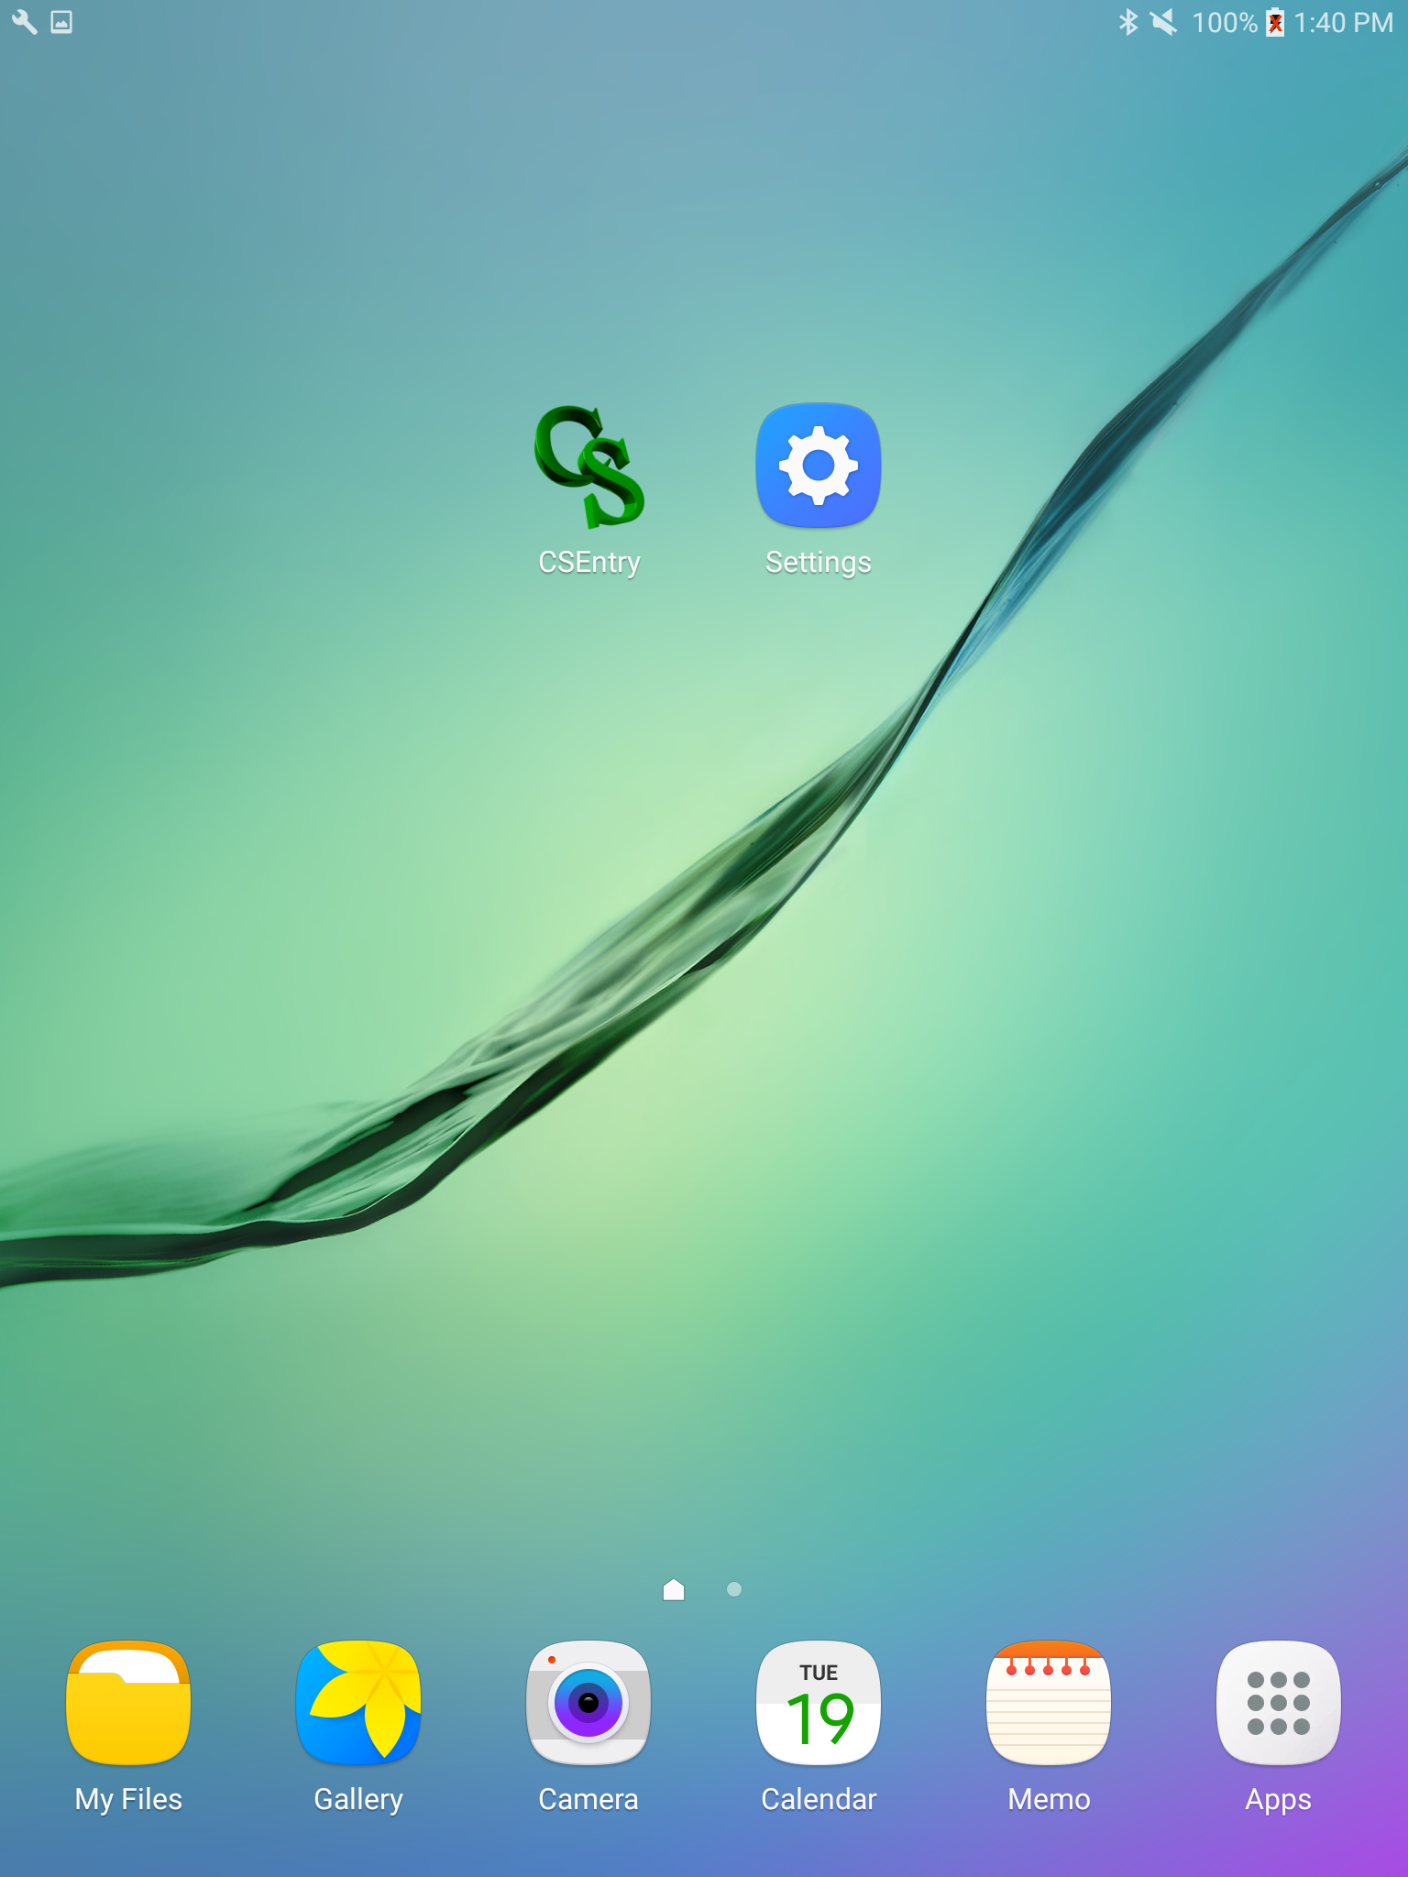
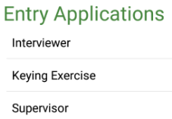
Find the CSEntry icon
Click on CSEntry icon from the home screen:
Choose the appropriate option:
Notes:
First step – recall how to login from last lecture!
ASK: Why would a supervisor ever use the interviewer menu?
Supervisors may wish to carry out interviews, they should use their interviewer program to do so
Help with work load

Slide 5
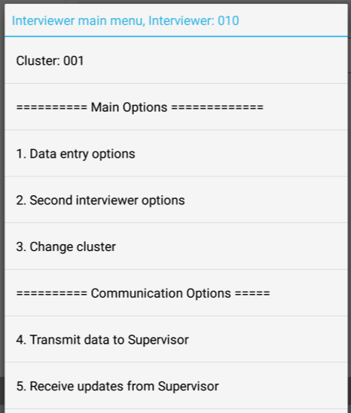
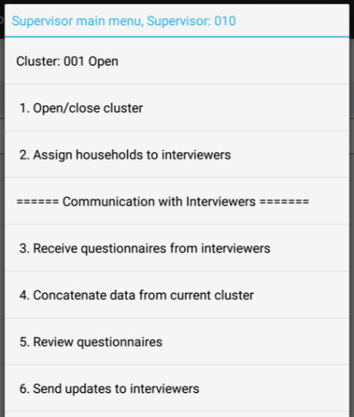
Check identifiers
Interviewer main menu
Supervisor main menu
Cluster number
Notes:
Note that interviewer names will appear on top of menu as well (just not during practice/training)
This is an example of the supervisor’s number being used in both interviewer and supervisor menu

Slide 6

Change cluster number
Interviewer main menu
Supervisor main menu
Notice options are different for interviewers/supervisors
Notes:
What if the cluster number IS wrong?? Change it!

Slide 7
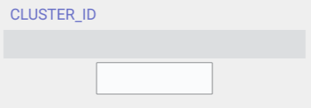
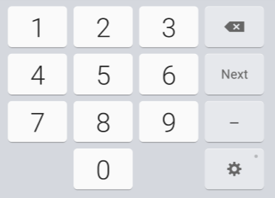

Change cluster number
Type in new cluster number, then click “Next”!
Notes:
Interviewer screen will return to main menu, but supervisor menu requires one additional step…

Slide 8
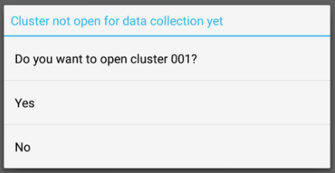
Change cluster number
First time in the cluster?
Supervisors – you must OPEN the cluster!
Notes:
Supervisors are in charge of the cluster, so when changing cluster numbers, they must first “open” the cluster. That is, tell CAPI that the team will now be working in that cluster, and to open it for data collection. Click yes and the screen will return to supervisor main menu ☺
If cluster has already been opened, you will not see this step – and likely our tablet will already be in correct cluster. Rarely should more than one cluster be open…
Yes, we will have to close clusters, but that will come later!

Slide 9
Check identifiers
Interviewer main menu
Supervisor main menu
Fieldworker number, assigned to tablet
Notes:
Back to the main menus….
Note that interviewer names will appear on top of menu as well (just not during practice/training)
This is an example of the supervisor’s number being used in both interviewer and supervisor menu
What is the interviewer number is wrong?? You likely have the wrong tablet! Otherwise contact supervisor, who will contact ICDM… shouldn’t be a problem though because FW numbers are assigned to a tablet.

Slide 10
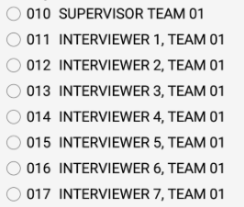
Fieldworker Numbers
Fieldworker number….
MEMORIZE IT. LOVE IT. KNOW IT.
Notes:
Make sure everyone in class knows their FW number – go around the room and have them say it out loud!
In the field (definitely) and in training (possibly depending on training setup), actual names will appear in this list. This slide is generic ☺
ASK: Why are first two digits all the same?
Represent the team number

Slide 11
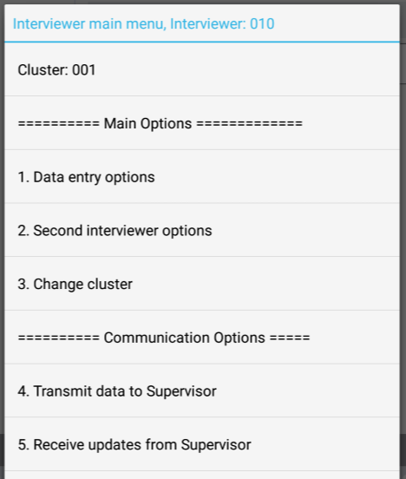
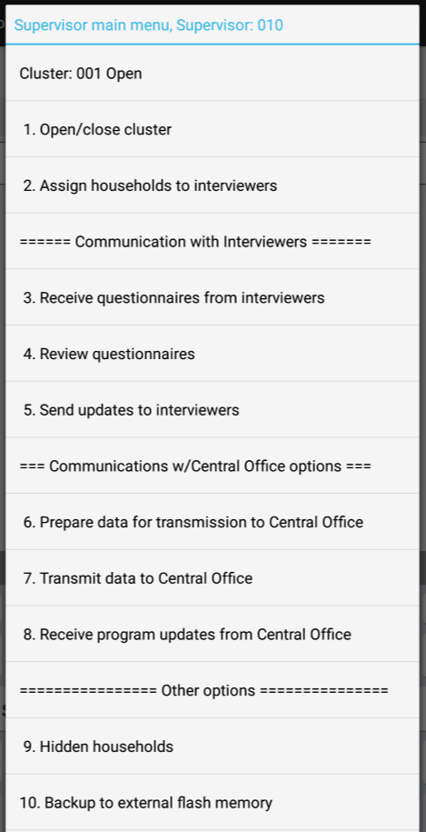
Begin work!
Interviewer menu
Supervisor menu
Notes:
Everything you need to do can be found in these two menus………

Slide 12
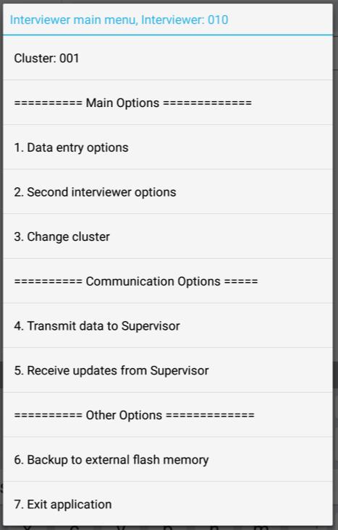

Exiting the system
Always exit using the last option on the menu!
Notes:
Exiting the system must be done through the menu!
If system freezes, you can use window icon at bottom of tablet and close the app – similar to ctrl+alt+delete… so not ideal

Slide 13

Practice time!
Access the appropriate menu, check interviewer and cluster number… then Exit properly!
Team 1 = Cluster 001
Team 2 = Cluster 002
Team 3 = Cluster 003…
Team 10 = Cluster 010…
Write FW code and cluster down!

